Slide 1
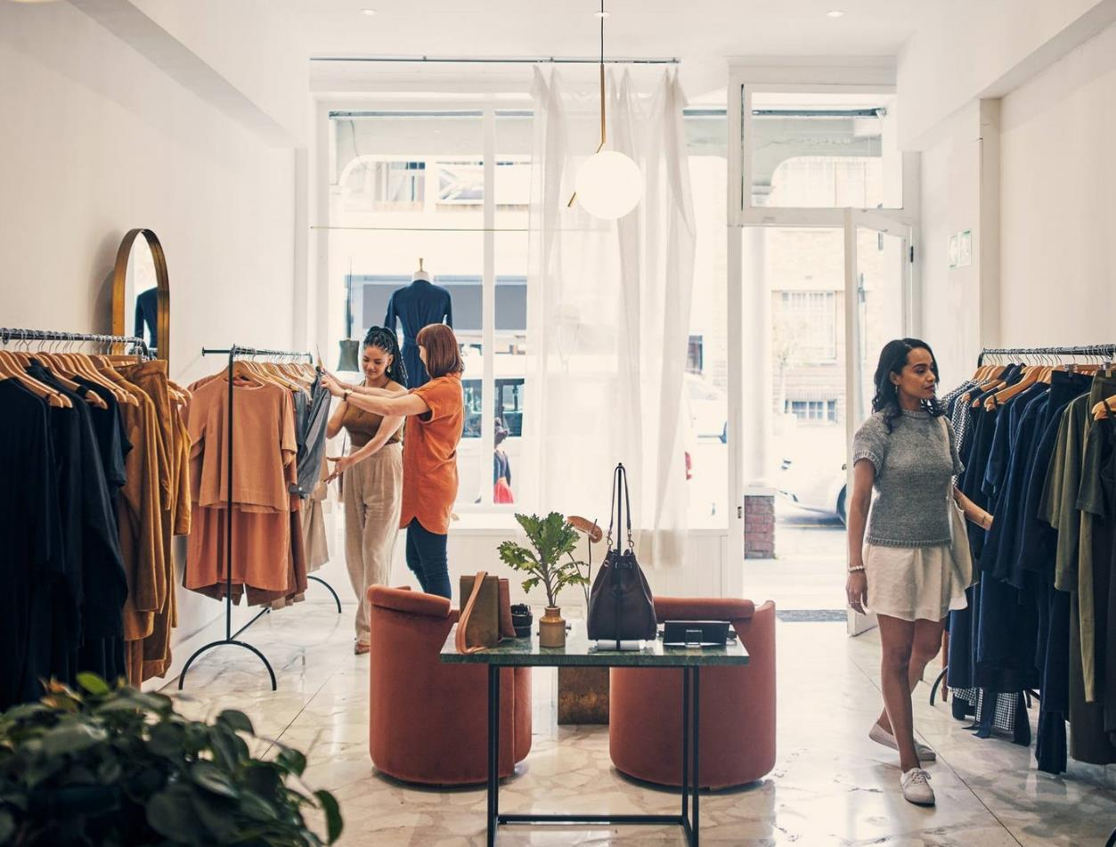
Myntra Analysis
A Data-Driven Approach to Improving Customer Satisfaction and Market Position

Slide 2

About Myntra
History: Founded in 2007–2008 as a personalized gift item seller, Myntra became an online fashion and lifestyle retailer in 2011. In 2014, Flipkart acquired Myntra, and in 2018, Walmart became a part of the company.
Products: Myntra sells a wide range of products, including apparel, accessories, cosmetics, footwear, jewelry, and personal care items. Some of the brands they carry include Adidas, Nike, Puma etc..
Services: Myntra offers a loyalty program called Myntra Insider, which provides members with discounts, priority delivery, early sales, and other deals.
Headquarters: Myntra is headquartered in Bengaluru, Karnataka, India.
CEO: Nandita Sinha is the CEO of Myntra.

Slide 3
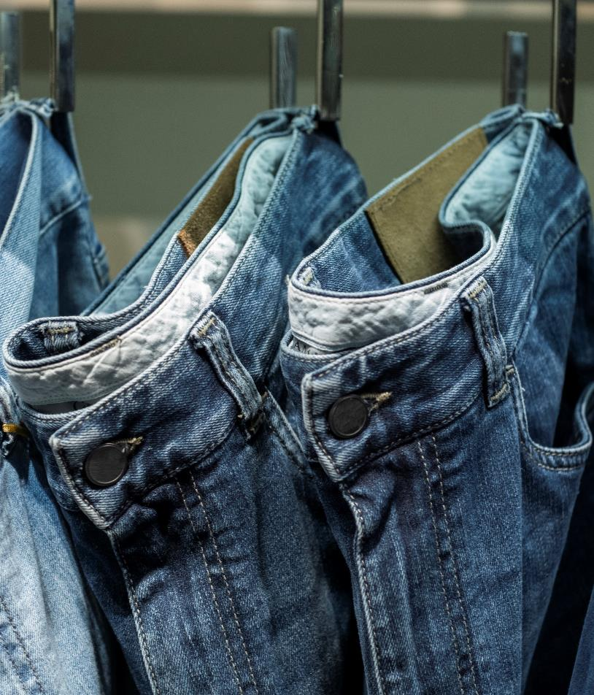
Analysis Objectives
Customer Sentiment Analysis: Uncover positive and negative feedback on Myntra’s products and services.
Brand Perception: Analyze how Myntra is viewed in the market.
Market Trend Identification: Detect emerging fashion trends influencing purchasing behavior.
Competitive Analysis: Compare Myntra’s offerings and service with its competitors.
Recommendations: Provide actionable strategies for growth and market positioning.

Slide 4
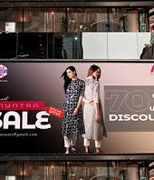
Insights into Customer Sentiments
Social Media Mentions: Insights from Twitter, Instagram, Facebook.
Customer Reviews: Data from Google Reviews, Trustpilot, Myntra’s product pages.
Sentiment Breakdown
Positive: Product variety, sales, app usability.
Negative: Delayed deliveries, product quality issues, refund difficulties.

Slide 5
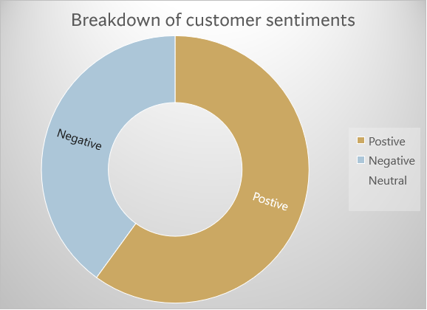
Sentiment Analysis - Visual Data
Visual Representation
Positive Sentiment: ~60% (Trendy products, good discounts, app experience).
Negative Sentiment: ~40% (Delivery issues, return problems, quality mismatches).

Slide 6

Brand Perception Analysis
Overall Perception:
Positive Attributes: Stylish, trendy, reliable.
Negative Attributes: Poor customer service, delays, inconsistent quality.
Customer Feedback Keywords: “Trendy,” “Great deals,” “Delayed,” “Damaged items.”
Social Media Sentiment Examples: Screenshots or quotes from social media posts reflecting both positive and negative perceptions.

Slide 7
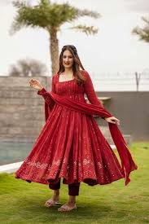
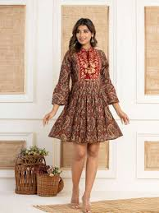
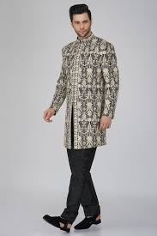
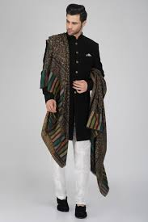
Current Market Trends in Fashion
Emerging Trends:
Sustainable Fashion: Increasing demand for eco-friendly clothing.
Ethnic Wear: High demand during festivals and weddings.
Athleisure & Casual Wear: Growing market for comfortable, stylish clothing post-pandemic.
Influencer-Driven Trends: Influencers shaping consumer purchasing through platforms like Instagram.

Slide 8


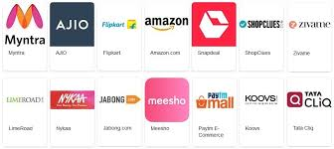
Competitive Landscape - Competitor Overview
Main Competitors: Amazon Fashion: Broader range, faster delivery, more reliable returns.
Flipkart: Wide e-commerce platform with fashion as a category.
AJIO: Focus on trendy and curated fashion collections.
Competitor Evaluation: Compare product range, delivery, returns, and customer satisfaction.

Slide 9
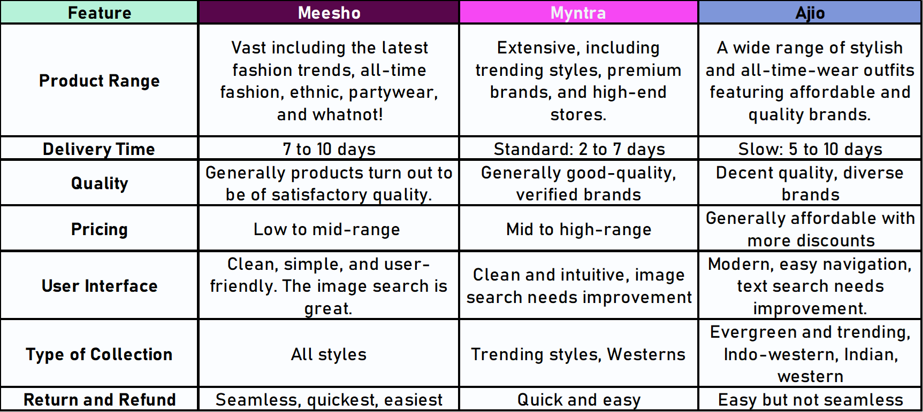
Competitive Landscape - Visual Comparison

Slide 10

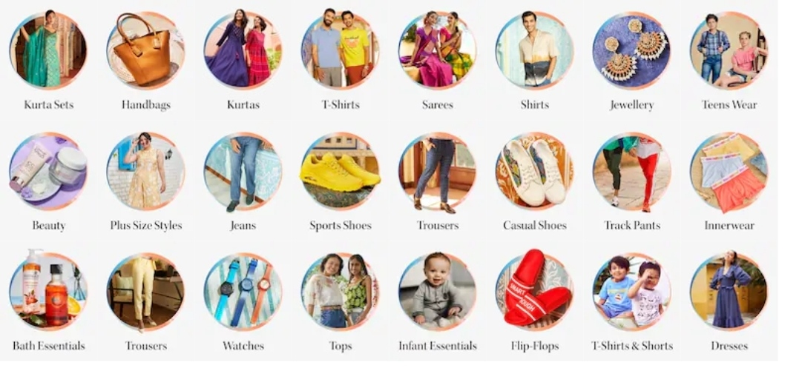

Strategic Recommendations-Enhancing Customer Experience, Product Offerings, and Marketing
Customer Experience:
Improve Delivery Speed: Strengthen logistics, especially during peak sales events.
Simplify Returns & Refunds: Make the process more user-friendly and transparent.
Ensure Product Quality: Focus on consistent quality control to reduce complaints about product inaccuracies.
Product & Market Trends:
Expand Sustainable Fashion: Launch a dedicated eco-friendly line to tap into growing demand.
Capitalize on Ethnic Wear: Offer exclusive festive collections and designer collaborations.
Boost Athleisure Line: Promote casual wear and athleisure to meet post-pandemic fashion needs.
Marketing & Positioning:
Personalized Promotions: Use customer data to deliver tailored offers.
Social Media Engagement: Increase interactive campaigns, influencer collaborations, and styling challenges.
Exclusive Designer Collaborations: Differentiate Myntra with high-profile, limited-edition partnerships.

Slide 11

Summary
Myntra has a strong brand presence but faces challenges with delivery and customer service.
Aligning with emerging fashion trends (sustainability, ethnic wear, athleisure) will position the brand for growth.
Implementing recommendations will help Myntra enhance customer satisfaction, strengthen market position, and stand out from competitors.
Focus on executing strategic changes in logistics, product offerings, and marketing to improve Myntra’s brand perception and market share.

Slide 12
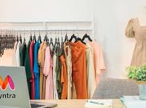
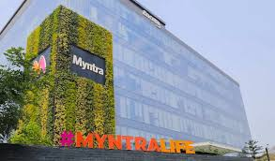
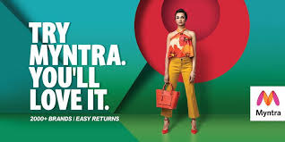



Thank you

